Slide 1
Document Object Model

Slide 2
Learning Objectives
This lesson provides an overview of the Document Object Model (DOM) and JavaScript events. By the end of this lesson, learners will be able to:
Navigate the DOM using JavaScript selectors.
Navigate between DOM nodes using relationship properties.
Add and remove content from the DOM.
Access and change DOM element attributes.
Change style attributes of elements using JavaScript.
Use Event Handlers and Event Listeners to perform actions in response to user interaction.

Slide 3
Table of Contents
Section One: DOM Properties and Methods
The HTML Document Object Model
The Document Object Model – Nodes
Useful DOM Objects, Properties, and Methods
Locating DOM Elements using Selectors
Document Structure and Traversal
Documents as Trees of Nodes
Node Relationships
Making Changes to the DOM
Section Two: JavaScript Events
Events in JavaScript
Event Handlers
Mouse Events
Form Events
Keyboard Events
Keyboard Events Properties

Slide 4
Section 1 DOM Properties and Methods

Slide 5
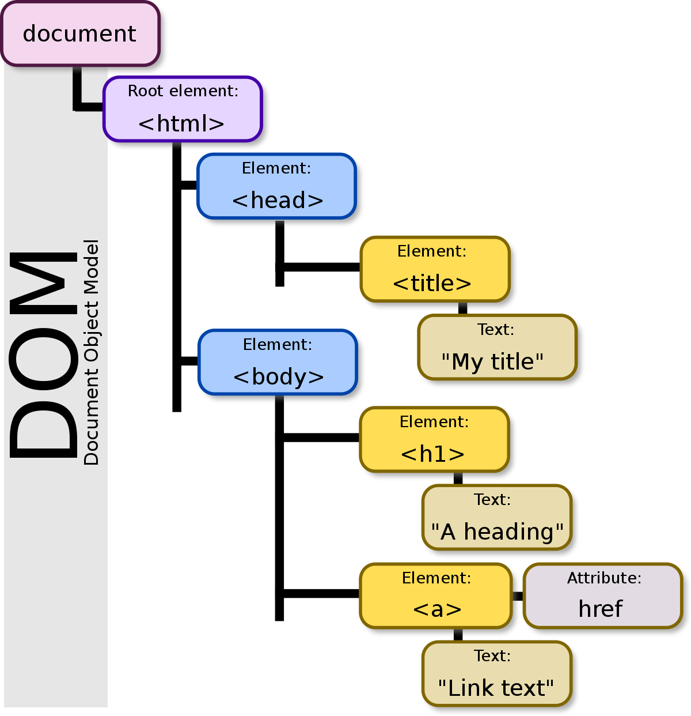
The HTML Document Object Model
The Document Object Model (DOM) is an interface that allows programs to dynamically access and update the content, structure, and style of a document.
DOM defines the logical structure of documents and the way a document is accessed and manipulated.
Javascript provides DOM class that defines HTML elements as objects. It support properties, methods, and events, which are available for the web developer for manipulating and creating web pages organized into objects. Those objects are accessible through modern web browsers.
In the DOM, all HTML elements are defined as objects.
Source: Birger Eriksson CC BY-SA 3.0 License
Notes:
The Document Object Model, or DOM, is the fundamental API for representing and manipulating the content of HTML and XML documents. The API is not particularly complicated, but there are a number of architectural details you need to understand.

Slide 6
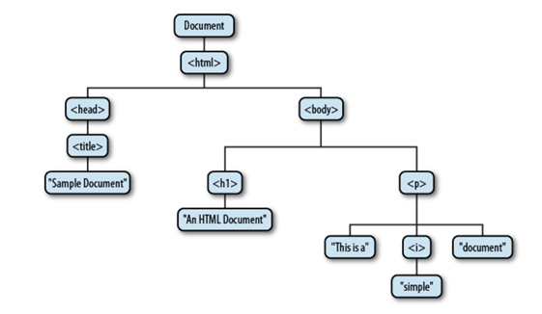
The HTML Document Object Model
An HTML document consists of nested HTML elements. The document can be viewed as a tree of elements. Each element is a child of the element that immediately encloses it. Similarly, each element is an ancestor of all the elements it encloses.
Consider the following simple HTML document:
<!DOCTYPE html>
<html lang="en">
<head>
<meta charset="UTF-8">
<title>Sample Document</title>
</head>
<body>
<h1>An HTML Document</h1>
<p>
This is a <i>simple</i> document.
</p>
</body>
</html>
The DOM representation of the document.
Notes:
The elements of a page are nested into a tree-like structure of objects. DOM has properties and methods for traversing this tree.
If you are not already familiar with tree structures in computer programming, it is helpful to know that they borrow terminology from family trees. The node directly above a node is the parent of that node. The nodes on the level directly below another node are the children of that node. Nodes at the same level, and with the same parent, are siblings. The set of nodes any number of levels below another node are the descendants of that node. And the parent, grandparent, and all other nodes above a node are the ancestors of that node.

Slide 7
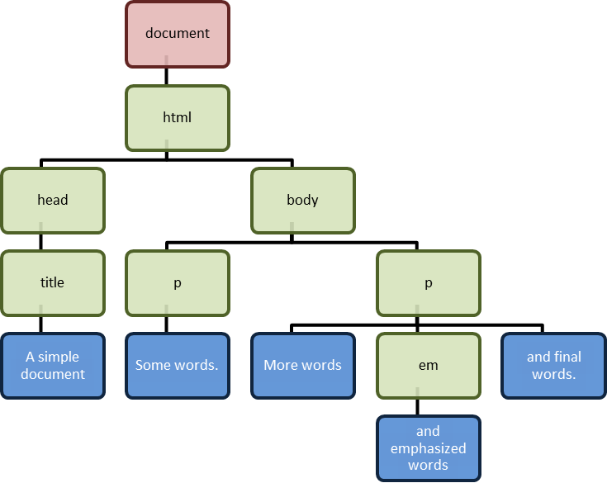
The Document Object Model – Nodes
A node is a generic name for any type of object in the DOM hierarchy. A node in this context is simply an HTML element. A node could be one of the built-in DOM elements such as document or document.body, an HTML tag specified in the HTML such as <input> or <p>, or it could be a text node that is created by the system to hold a block of text inside another element.
Each HTML element is represented by an object. Each object has various properties and methods that correspond to the appearance or behavior of the corresponding HTML element. The object also has parents, children, and siblings as specified by the DOM tree.
In this example, the <body> element is the parent of two <p> child nodes and the ancestor to the one <em> node.
Notes:
At the root of the tree is the Document node that represents the entire document. The nodes that represent HTML elements are Element nodes, and the nodes that represent text are Text nodes. The Document, Element, and Text are subclasses of Node and have their own entries in the reference section. Document and Element are the two most important DOM classes

Slide 8
Useful DOM Objects, Properties, and Methods
The following are some useful objects, properties, and methods of the document object:
document.anchors: Returns all <a> elements that have a name attribute.
document.baseURI: Returns the absolute base URI of the document.
document.body: Returns the <body> element.
document.cookie: Returns the document's cookie.
document.doctype: Returns the document's doctype.
document.documentElement: Returns the <html> element.
document.documentMode: Returns the mode used by the browser.
document.documentURI: Returns the URI of the document.
document.domain: Returns the domain name of the document server.
document.embeds: Returns all <embed> elements.
document.scripts: Returns all <script> elements.
document.strictErrorChecking: Returns if error checking is enforced.
document.title: Returns the <title> element.
document.URL: Returns the complete URL of the document.
document.forms: Returns all <form> elements.
document.head: Returns the <head> element.
document.images: Returns all <img> elements.
document.implementation: Returns the DOM implementation.
document.inputEncoding: Returns the document's encoding (character set).
document.lastModified: Returns the date and time the document was updated.
document.links: Returns all <area> and <a> elements that have a href attribute.
document.referrer: Returns the URI of the referrer (the linking document).

Slide 9
Locating DOM Elements using Selectors
In order to manipulate elements of the document, you must somehow obtain or select the element objects that represent the page elements of interest.
The DOM defines several ways to select elements, which we will discuss on the following slides. You can query a document for an element or elements by using:
Document/HTML object collections.
A specific id attribute.
A specific name attribute.
A specific tag name.
A Cascading Style Sheet (CSS) class or classes.
A CSS selector expression.

Slide 10
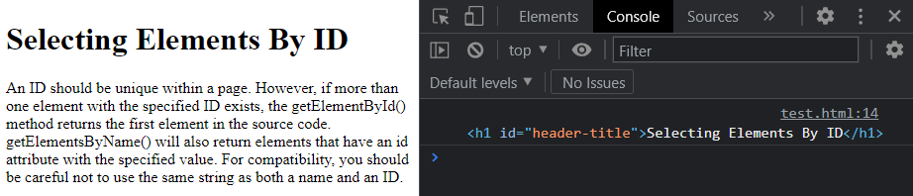
Selecting Elements by ID
Any HTML element can have an id attribute, but no two elements in a document should have the same id.
You can select an element based on this unique id with the getElementById() method of the document object, which returns an element object representing the element whose id property matches the specified string.
<!DOCTYPE html>
<html lang="en">
<head></head>
<body>
<header id="main-header">
<div class="container">
<h1 id="header-title">Selecting Elements By ID</h1>
An ID should be unique within a page. However, if more than one element with the specified ID exists, the getElementById() method returns the first element in the source code.
</div>
</header>
<div>getElementsByName() will also return elements that have an id attribute with the specified value. For compatibility, you should be careful not to use the same string as both a name and an ID.</div>
<script>
let header = document.getElementById('header-title');
console.log(header);
</script>
</body>
</html>
Notes:
An ID should be unique within a page. However, if more than one element with the specified ID exists, the getElementById() method returns the first element in the source code.
This is the simplest and most common way to select elements. If your script is going to manipulate a specific set of document elements, give those elements id attributes, and look up the element objects using that ID.

Slide 11
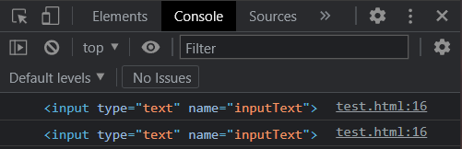
Selecting Elements by Name
To select HTML elements based on the value of their name attributes, we can use the getElementsByName() method of the document object, which returns a collection of all elements in the document with the specified tag name as a NodeList object. NodeList objects behave like a read-only array of Element objects.
<!DOCTYPE html>
<html lang="en">
<head></head>
<body>
<header id="main-header">
<div class="container">
<h1 id="header-title">Selecting Elements By Name</h1>
An ID should be unique within a page. However, if more than one element with the specified ID exists, the getElementById() method returns the first element in the source code.</div>
</header>
<div>getElementsByName() will also return elements that have an id attribute with the specified value. For compatibility, you should be careful not to use the same string as both a name and an id.</div>
<input type="text" name="inputText"/>
<input type="text" name="inputText"/>
<script>
let items = document.getElementsByName("inputText");
for (const itemsKey in items) {
console.log(items[itemsKey])
}
</script>
</body>
</html>
Notes:
Like the ID attribute, Name assigns a name to an element; however, unlike ID, the value of a name attribute does not have to be unique.
If there is only a single element with a given name, the value of the automatically created document property is the element itself. If there is more than one element, then the value of the property is a NodeList object that acts as an array of element.
This is common in the case of radio buttons and checkboxes ins forms.

Slide 12
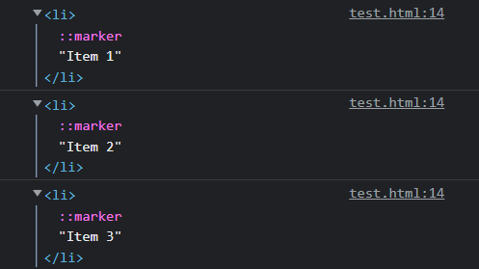
Selecting Elements by Type
You can select all HTML elements of a specified type (or tag name) using the getElementsByTagName() method of the document object.
The getElementsByTagName() method returns a collection of all elements in the document with the specified tag name as a NodeList object.
<!DOCTYPE html>
<html lang="en">
<head></head>
<body>
<div>The elements of the returned NodeList are in document order, so you can select the first "li" element of a document like this: "document.getElementsByTagName("li")[0]".</div>
<ul>
<li>Item 1</li>
<li>Item 2</li>
<li>Item 3</li>
</ul>
<script>
let li = document.getElementsByTagName('li');
for (const liKey in li) {
console.log(li[liKey])
}
</script>
</body>
</html>
Notes:
HTML tags are case-insensitive, and when getElementsByTagName() is used on an HTML document, it performs a case-insensitive tag name comparison.
You can obtain a NodeList that represents all elements in a document by passing the wildcard argument “*” to getElementsByTagName()

Slide 13
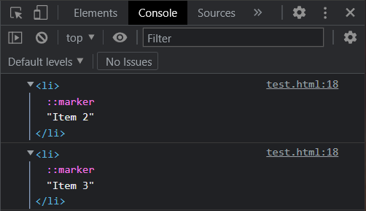
NodeLists and HTMLCollections
getElementsByName() and getElementsByTagName() return NodeList objects and properties such as document.images and document.forms in HTMLCollection objects.
These objects are read-only, array-like objects. They have length properties and can be indexed (for reading but not writing) like true arrays. You can iterate the contents of a NodeList or HTMLCollection with a standard loop. You cannot invoke Array methods on NodeList and HTMLCollection directly, but you can do so indirectly.
<!DOCTYPE html>
<html lang="en">
<head></head>
<body>
<div>The elements of the returned NodeList are in document order, so you can select the first "li" element of a document like this: "document.getElementsByTagName("li")[0]".</div>
<ul>
<li>Item 1</li>
<li>Item 2</li>
<li>Item 3</li>
<li>Item 4</li>
</ul>
<script>
let li = document.getElementsByTagName('li');
// will give an error
// let myArr = li.slice(1,3);
let myArry = Array.prototype.slice.call(li,1,3);
for (const myArryKey in myArry) {
console.log(myArry[myArryKey])
}
</script>
</body>
</html>

Slide 14
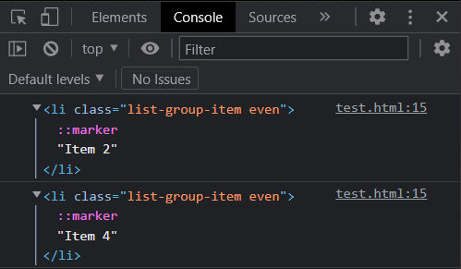
Selecting Elements by CSS Class
The class attribute is usually used in conjunction with a CSS stylesheet to apply the same presentation styles to all members of a set.
<!DOCTYPE html>
<html lang="en">
<head></head>
<body>
<div>The order of the identifiers does not matter. Note that both the class attribute and the getElementsByClassName() methods separate class identifiers with spaces, not with commas.</div>
<ul id="items" class="list-group">
<li class="list-group-item odd">Item 1</li>
<li class="list-group-item even">Item 2</li>
<li class="list-group-item odd">Item 3</li>
<li class="list-group-item even">Item 4</li>
</ul>
<script>
let items = document.getElementsByClassName("even list-group-item");
for (const itemsKey in items) {
console.log(items[itemsKey])
}
</script>
</body>
</html>
Notes:
getElementsByTagName(), getElementsByClassName() can be invoked on both HTML documents and HTML elements, and it returns a live NodeList containing all matching descendants of the document or element.
getElementsByClassName() takes a single string argument, but the string may specify multiple space-separated identifiers. Only elements that include all of the specified identifiers in their class attribute are matched.
The order of the identifiers does not matter. Note that both the class attribute and the getElementsByClassName() methods separate class identifiers with spaces, not with commas.

Slide 15
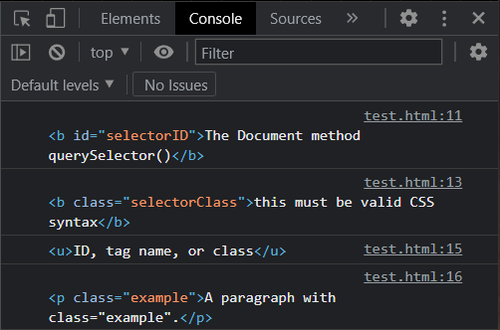
Selecting Elements with CSS Selectors
The querySelector() method returns the first element that matches a specified CSS selector or multiple selectors in the document.
<!DOCTYPE html>
<html lang="en">
<head></head>
<body>
<p id="main">
<b id="selectorID">The Document method querySelector()</b> returns the first Element within the document that matches the specified selector, or group of selectors, <b class="selectorClass">this must be valid CSS syntax</b>, or a SyntaxError exception will occur. Elements can be described by <u>ID, tag name, or class</u>.
</p>
<p class="example">A paragraph with class="example".</p>
<script>
const selectorID = document.querySelector('#selectorID');
console.log(selectorID);
const selectorClass = document.querySelector('.selectorClass');
console.log(selectorClass);
const selectorTag = document.querySelector('u');
console.log(selectorTag);
console.log(document.querySelector("p.example"));
</script>
</body>
</html>

Slide 16
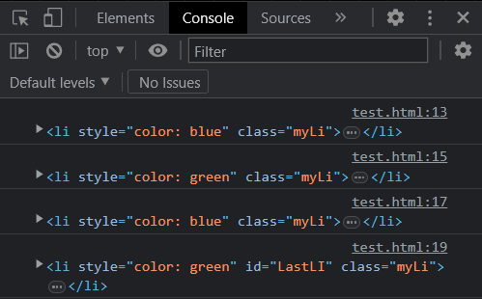
Selecting Elements with CSS Selectors (continued)
CSS stylesheets have a very powerful syntax, known as selectors, for describing elements or sets of elements within a document. Full details of CSS selector syntax are beyond the scope of this presentation, but we will try to summarize the basics.
<!DOCTYPE html>
<html lang="en">
<head></head>
<body>
<ul>
<li style="color: blue" class="myLi">More generally, elements can be selected based on attribute values.</li>
<li style="color: green" class="myLi"><b>Selectors can also specify document structure.</b></li>
<li style="color: blue" class="myLi"><u>These basic selectors can be combined.</u></li>
<li style="color: green" id="LastLI" class="myLi">You can select multiple elements or multiple sets of elements.</li>
</ul>
<script>
const q1 = document.querySelector('li[style="color: blue"]');
console.log(q1);
const q2 = document.querySelector('li[style="color: green"]');
console.log(q2);
const q3 = document.querySelector('li[style="color: blue"]');
console.log(q3);
const q4 = document.querySelector('#LastLI');
console.log(q4);
</script>
</body>
</html>

Slide 17
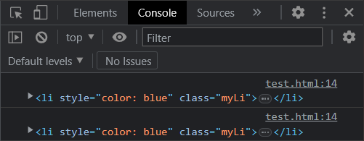
Selecting Elements with CSS Selectors (continued)
The document method querySelectorAll() takes a single string argument containing a CSS selector and returns a NodeList that represents all elements in the document that match the selector.
In order to be selected, an element must match the provided structure of the selector (in the case of the example, 'li[style="color: blue"]').
<!DOCTYPE html>
<html lang="en">
<head></head>
<body>
<ul>
<li style="color: blue" class="myLi">More generally, elements can be selected based on attribute values.</li>
<li style="color: green" class="myLi"><b>Selectors can also specify document structure.</b></li>
<li style="color: blue" class="myLi"><u>These basic selectors can be combined.</u></li>
<li style="color: green" id="LastLI" class="myLi">You can select multiple elements or multiple sets of elements.</li>
</ul>
<script>
const q1 = document.querySelectorAll('li[style="color: blue"]');
for (const q1Key in q1) {
console.log(q1[q1Key])
}
</script>
</body>
</html>

Slide 18
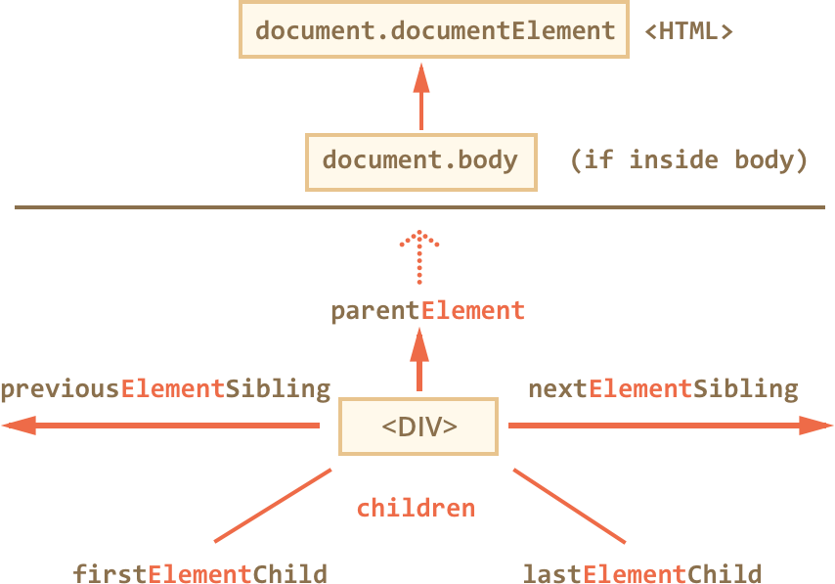
Document Structure and Traversal
We know that the DOM is structured as a tree of nodes with the document node at the root and every other node (including elements, comments, and text nodes) as the various branches.
Often, you will want to move through the DOM without specifying each element beforehand. For these cases, we can navigate up and down the DOM tree and move from branch to branch with the parent, child, and sibling properties.
https://javascript.info/dom-navigation

Slide 19
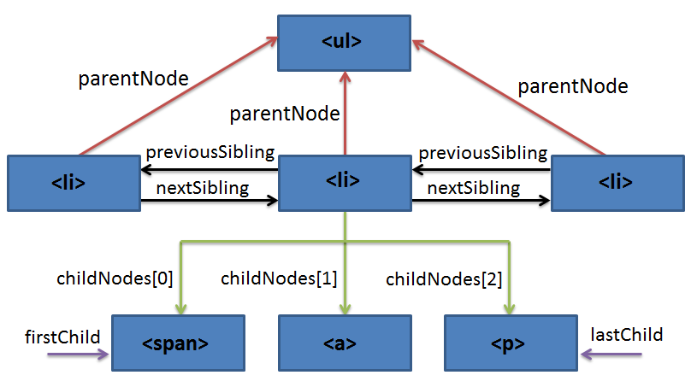
Documents as Trees of Nodes
In the DOM, element objects and the text objects that represent text in the document are all Node objects. Node defines the following important properties:
Root Nodes.
Parent Nodes.
Children Nodes.
Sibling Nodes.
The nodes in the DOM are referred to as parents, children, and siblings depending on their relation to other nodes as shown in the representation to the right.
Source: Dai Pho Web & Hosting

Slide 20
Node Relationships – Example
You can use the following node properties to navigate between nodes with JavaScript:
parentNode
childNodes[node-number]
firstChild
lastChild
nextSibling
previousSibling
Consider the following code:
<html>
<head>
<title>DOM Tutorial</title>
</head>
<body>
<h1>DOM Lesson One</h1>
<p>Hello world!</p>
</body>
</html>
In the example code to the left:
<html> is the root node
<html> has no parents
<html> is the parent of <head> and <body>
<head> is the first child of <html>
<body> is the last child of <html>
<head> has one child: <title>
<title> has one child (a text node): "DOM Tutorial"
<body> has two children: <h1> and <p>
<h1> has one child: "DOM Lesson one"
<p> has one child: "Hello world!"
<h1> and <p> are siblings

Slide 21
Root Nodes
The document object is the root of every node in the DOM. This object is a property of the window object, which is the global, top-level object representing a tab in the browser (more on the window object later).
Since the html, head, and body elements are so commonly used, they have their own properties in the document object: (document.documentElement, document.head, document.body respectively).

Slide 22
Parent Nodes
The parent of any node is the node that is one level above it, or closer to the document in the DOM hierarchy. There are two properties to get the parent: parentNode and parentElement.
In the example to the right:
html is the parent of head, body and script.
body is the parent of ul, but not li, since li is two levels down from body.
Note: Using parentNode twice, we could retrieve the grandparent ancestor.
<!DOCTYPE html>
<html lang="en">
<head></head>
<body>
<h1>Parent Nodes</h1>
<ul>
<li>Node.parentNode: The parent of an element is an Element node, a Document node, or a DocumentFragment node.</li>
<li>Node.parentElement: This is always a DOM Element object, or null.</li>
</ul>
</body>
<script>
console.log(document.querySelector('ul').parentNode);
console.log(document.querySelector('li').parentNode);
</script>
</html>

Slide 23
Children Nodes
In this example, the ul element has four child li elements.
firstChild and lastChild: The first and last child nodes of a node, or null if the node has no children.
The difference between the firstChild and firstElementChild properties is that firstChild returns the first child node as an element node, a text node, or a comment node (depending on which one is first), while firstElementChild returns exclusively the first element node (ignores text and comment nodes).
<!DOCTYPE html>
<html lang="en">
<head></head>
<body>
<h1>Children Nodes</h1>
<ul>
<li>firstElementChild</li>
<li>childNodes</li>
<li>children</li>
<li>lastElementChild</li>
</ul>
<div>Use the children property to return any child element of a specified element. To return the last child element of a specified element, use the lastElementChild property.</div>
<script>
console.log(document.querySelector('ul').firstElementChild);
console.log(document.querySelector('ul').lastElementChild);
console.log(document.querySelector('ul').childNodes);
</script>
</body>
</html>
Notes:
The children of a node are the nodes that are one level below it. Any nodes beyond one level of nesting are usually referred to as descendants. The childNodes property will return a list of every child of a node.

Slide 24
Sibling Nodes
The siblings of a node are any node on the same tree level in the DOM. Siblings do not have to be the same type of node. Text, element, and comment nodes can all be siblings.
Sibling properties work the same way as children nodes, in that there is a set of properties to traverse all nodes, and a set of properties for only element nodes: previousSibling and nextSibling will get the next node that immediately precedes or follows the specified node, and previousElementSibling and nextElementSibling will only get element nodes.
Source: Dai Pho Web & Hosting

Slide 25
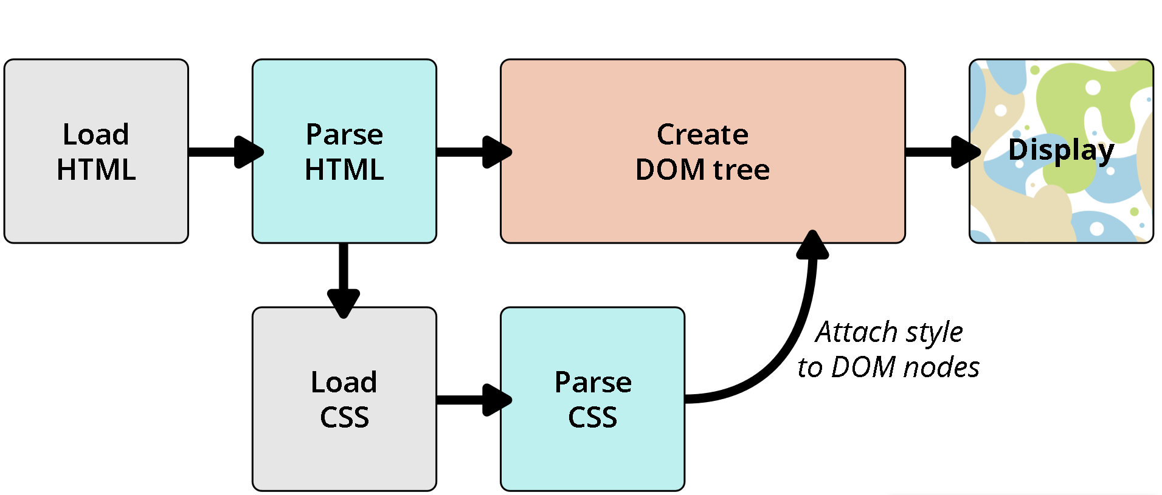
Making Changes to the DOM
We have explored how to query the document using strings of HTML and plain text. We have also seen that we can traverse a document to examine the individual element and text nodes that it is made of.
It is also possible to alter a document at the level of individual nodes. The document type defines methods for creating element and text objects, and the Node type defines methods for inserting, deleting, and replacing nodes in the tree.
Source: Mozilla

Slide 26
The innerHTML Property
The easiest way to access the content of an element is by using the innerHTML property. The innerHTML property is useful for getting or replacing the content of HTML elements, including <html> and <body>.
It is used in web pages to generate dynamic HTML such as registration forms, comment forms, links etc.
In the example on the right, we are dynamically writing the HTML data inside the div element with the id “mylocation”. We are selecting this element by calling the document.getElementById() method.
<html>
<head>
<script type="text/javascript">
function editHTML() {
document.getElementById('mylocation').innerHTML = "Your location is USA.";
}
</script>
</head>
<body>
<form name="myForm">
<input type="button" value="Show My Location" onClick="editHTML()">
<h3>Your location will show below, please click on the button.</h3>
<div id="mylocation"></div>
</form>
</body>
</html>

Slide 27
Inserting Nodes into the DOM
With these methods, we have created new elements and text nodes, but they are not visible on the front end of a website until they have been inserted into the document.
The methods appendChild() and insertBefore() are used to add items to the beginning, middle, or end of a parent element, and replaceChild() is used to replace an old node with a new node.
<!DOCTYPE html>
<html lang="en">
<head></head>
<body>
<h1>Inserting Nodes</h1>
<ul>
<li id="useless">Nothing to see here</li>
</ul>
<script>
const ul = document.querySelector('ul');
const newElement = document.createElement('li');
newElement.textContent = "node.appendChild(): Add a node as the last child of a parent element";
ul.appendChild(newElement);
const anotherElement = document.createElement('li');
anotherElement.textContent = "node.insertBefore(): Insert a node into the parent element before a specified sibling node";
ul.insertBefore(anotherElement, newElement);
const uselessElemen = document.querySelector('#useless');
const aDifferentElement = document.createElement('li');
aDifferentElement.textContent ="node.replaceChild(): Replace an existing node with a new node";
ul.replaceChild(aDifferentElement, uselessElemen);
</script>
</body>
</html>
Notes:
In order to add a new item to the end of the to-do list, we have to create the element and add text to it first, as we did in the "Creating New Nodes" section above.
We can add it to the beginning of the list using insertBefore(). This method takes two arguments — the first is the new child node to be added, and the second is the sibling node that will immediately follow the new node. In other words, you're inserting the new node before the next sibling node.
Like insertBefore(), replaceChild() takes two arguments — the new node, and the node to be replaced
Note: If you call appendChild() or insertBefore() to insert a node that is already in the document, that node will automatically be removed from its current position and reinserted at its new position: there is no need to explicitly remove the node.

Slide 28
Creating New Nodes
In a static website, elements are added to the page by directly writing HTML in an .html file. In a dynamic web app, elements and text are often added with JavaScript.
The createElement() and createTextNode() methods are used to create new nodes or elements and content in the DOM.
<!DOCTYPE html>
<html lang="en">
<head></head>
<body>
<h1>Creating New Nodes</h1>
<ul>
<li>document.createElement(): Create a new element node.</li>
<li>document.createTextNode(): Create a new text node.</li>
<li>node.textContent: Get or set the text content of a node.</li>
<li>node.innerHTML: Get or set the HTML content of an element.</li>
</ul>
<script>
const newElement = document.createElement('p');
newElement.textContent = "We've created a new p element on the document by using the createElement() method. In order to add text to the element, we can use the textContent property.";
console.log(newElement);
newElement.innerHTML="The innerHTML property allows you to add <strong>HTML</strong> as well as text to an element."
console.log(newElement);
const newTextNode = document.createTextNode("It is also possible to create a text node with the createTextNode() method.");
console.log(newTextNode);
</script>
</body>
</html>
Notes:
The createTextNode() method creates a Text Node with the specified text. The createElement() method to create an Element Node with the specified name.
After the Text Node is created, use the element.appendChild() or element.insertBefore() method to append it to an element.

Slide 29
Removing Nodes
The removeChild() method removes a node from the document tree.
Invoke the method on the parent node and pass the child node that is to be removed as the method argument. The remove() method removes the object from the tree it belongs to.
<!DOCTYPE html>
<html lang="en">
<head></head>
<body>
<h1>Removing Nodes</h1>
<ul>
<li>Now you see me</li>
<li>removeChild(): removes a child node from the DOM and returns the removed node.</li>
<li>remove(): removes the object from the tree it belongs to.</li>
<li id="useless">and now you don't</li>
</ul>
<script>
const ul = document.querySelector('ul');
ul.removeChild(ul.firstElementChild);
const uselessElement = document.querySelector('#useless');
uselessElement.remove();
</script>
</body>
</html>
Notes:
Be careful, however; this method is not invoked on the node to be removed but on the parent of that node.

Slide 30
Modifying Styles
The style property represents the inline styles on an HTML element. Often, styles will be applied to elements via a stylesheet, but sometimes we must add or edit an inline style directly.
One option to edit the styles is with setAttribute(). However, this will remove all existing inline styles from the element. Since this is likely not the intended effect, it is better to use the style attribute directly.
<!DOCTYPE html>
<html lang="en">
<head></head>
<body>
<div id= "myDiv">Modifying Styles</div>
<script>
const div = document.querySelector('#myDiv');
// Edit the styles is with setAttribute()
div.setAttribute('style', 'text-align: center');
// Apply style to div directly.
div.style.backgroundColor= 'coral';
div.style.color= 'white';
div.style.height = '100px';
div.style.width = '100px';
div.style.border = '2px solid black';
// Make div into a circle and center the text
div.style.borderRadius = '50%';
div.style.display = 'flex';
div.style.justifyContent = 'center';
div.style.alignItems = 'center';
</script>
</body>
</html>
Notes:
If many stylistic changes are to be applied to an element, the best course of action is to apply the styles to a class and add a new class. However, there are some cases in which modifying the inline style attribute will be necessary or more straightforward.
CSS properties are written in kebab-case, which is lowercase words separated by dashes. This cannot be used on the JavaScript style property. Instead, camelCase equivalents are used, which is when the first word is lowercase, and all subsequent words are capitalized. So instead of "text-align, " we use "textAlign" for the JavaScript style property.

Slide 31
Section 2 JavaScript Events

Slide 32
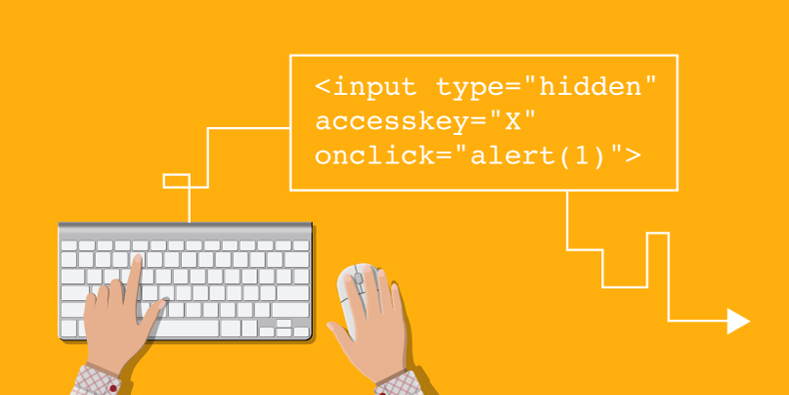
Events in JavaScript
Events are actions that take place in the browser that can be initiated by either the user or the browser itself. Events allow JavaScript to register different event handlers on elements in an HTML document.
Events are normally used in combination with functions, and the function will not be executed before the event occurs (such as when a user clicks a button).
By coding JavaScript responses that execute upon an event, developers can display messages to users, validate data, react to a button click, and implement many other interactions.
http://mason.gmu.edu/
Notes:
Some examples of common events that can happen on a website include pages that finish loading; users clicking a button, hovering over a dropdown menu, or submitting a form, or users pressing a key on the keyboard.

Slide 33
Event Handlers
Each event may have an event handler, which is a block of code that will execute when the event occurs. There are three ways to assign events to elements:
Inline event handlers – object.EventName() = function() { myScript };
Event handler properties – object.EventName = methodName();
Event listeners – object.addEventListener("EventName", myScript);

Slide 34
Inline Event Handlers
Inline events are bound to an element by their attribute name, which starts with the “on” prefix.
onchange is usually associated with text input fields, and a handler can be set in HTML with an attribute named on<event>. For instance, to assign a click handler for an input tag, we can use "onclick."
It is more practical to maintain a separate stylesheet of CSS classes than to create inline styles on every element. Similarly, it is more feasible to maintain JavaScript that is handled entirely through a separate script file than to add handlers to every element.
<!DOCTYPE html>
<html lang="en-US">
<head><title>Events</title></head>
<body>
<button onclick="changeText()">Click me</button>
<p>Try to change me.</p>
<script>
// Function to modify the text content of the paragraph
function changeText() {
const p = document.querySelector('p');
p.textContent = "Changed because of an inline event handler.";
}
</script>
</body>
</html>
Notes:
Not all event types may be bound to all elements.

Slide 35
Event Handler Properties
Event Handler properties work similar to inline handlers, except we set the property of an element in JavaScript instead of the attribute in the HTML.
The event handler property is slightly more maintainable than the inline handler, but it still suffers from some of the same hurdles. For example, trying to set multiple, separate "onclick" properties will cause all but the last one to be overwritten.
<!DOCTYPE html>
<html lang="en-US">
<head><title>Events</title></head>
<body>
<button>Click me</button>
<p>Try to change me.</p>
<script>
const button = document.querySelector('button');
// Function to modify the text content of the paragraph
function changeText() {
const p = document.querySelector('p');
p.textContent = "Changed because of an event handler property.";
button.textContent = "I was clicked";
}
// Add event handler as a property of the button element
button.onclick = changeText;
</script>
</body>
</html>
Notes:
q

Slide 36
Event Listeners
An Event Listener is a function with an explicit name (if it is reusable) or an anonymous function (in case it is used one time).
When a user clicks a button or presses a key, an event is fired. These are called click events or keypress events, respectively. An event listener attaches a responsive interface to an element, which allows that element to wait and "listen" for the given event to fire.
Event Handlers provide two main methods for registering and deregistering event listeners:
addEventListener() – register an event handler.
removeEventListener() – remove an event handler.

Slide 37
Event Listeners (continued)
Event listeners are currently the most common and preferred way to handle events in JavaScript. An event listener watches for an event on an element. Instead of assigning the event directly to a property on the element, we will use the addEventListener() method to listen for the event.
addEventListener() takes two mandatory parameters — the event it is to be listening for, and the listener callback function.
<!DOCTYPE html>
<html lang="en-US">
<head><title>Events</title></head>
<body>
<button>Click me</button>
<p>Try to change me.</p>
<script>
const button = document.querySelector('button');
// Function to modify the text content of the paragraph
const changeText = () => {
const p = document.querySelector('p');
p.textContent = "Changed because of an event listener.";
button.textContent="I was clicked";
}
// Listen for click event
button.addEventListener('click', changeText);
</script>
</body>
</html>
Notes:
Notice that with the first two methods, a click event was referred to as onclick, but with event listeners it is referred to as click. Every event listener drops the on from the word. In the next section, we will look at more examples of other types of events.
It is also possible to use the removeEventListener() function to remove one or all events from an element.
Furthermore, you can use addEventListener() on the document and window object.
Unlike with event handler properties, multiple listeners can be added to the same event and element by using the addEventListener() method.

Slide 38
Mouse Events
Mouse events are among the most frequently used events. They refer to events that involve clicking buttons on the mouse or hovering and moving the mouse pointer. These events also correspond to the equivalent action on a touch device.
Event | Event Handler | Description
click | onclick | When mouse click on an element or fires when the mouse is pressed and released on an element
mouseover | onmouseover | When the cursor of the mouse comes over the element
mouseout | onmouseout | When the cursor of the mouse leaves an element
mousedown | onmousedown | When the mouse button is pressed over the element
mouseup | onmouseup | When the mouse button is released over the element
mousemove | onmousemove | Fires every time a pointer moves inside an element or when the mouse movement takes place.
mouseenter | onmouseenter | Fires when a pointer enters an element
mouseleave | onmouseleave | Fires when a pointer leaves an element
A click is a compound event that is comprised of combined mousedown and mouseup events, which fire when the mouse button is pressed down or lifted, respectively.
Using mouseenter and mouseleave in tandem recreates a hover effect that lasts for as long as a mouse pointer is on the element.

Slide 39
Mouse Events – Example: onclick
<html>
<head><title>Javascript Events</title></head>
<body>
<form>
<input type="button" onclick="clickEvent()" value="Who's this?"/>
</form>
<script type="text/Javascript">
function clickEvent() {
alert("This is PerScholas");
}
</script>
</body>
</html>

Slide 40
Mouse Events – Example: onmouseover
<html>
<head><title>Javascript Events</title></head>
<body>
<p onmouseover="mouseOverEvent()">Keep cursor over me</p>
<script type="text/Javascript">
function mouseOverEvent() {
alert("This is Perscholas and you are Learners");
}
</script>
</body>
</html>

Slide 41
Form Events
Form events are actions that pertain to forms, such as input elements being selected or unselected, and forms being submitted.
Focus is achieved when an element is selected, such as through a mouse click or navigating to it via the TAB key, and there are events tied to element focus.
JavaScript is often used to submit forms, and send the values through to a back-end language.
<html lang="en-US">
<head></head>
<body>
<form>
<label for="fname">First name:</label><br>
<input type="text" id="fname"><br>
<input type="submit" value="Submit">
</form>
<script>
const name = document.getElementById("fname");
name.addEventListener('focus', changeToCoral);
name.addEventListener('blur', changeToWhite);
document.querySelector('form').addEventListener("submit", function() {
alert(name.value);
});
function changeToCoral() { name.style.backgroundColor = 'coral'; }
function changeToWhite() { name.style.backgroundColor = 'white'; }
</script>
</body>
</html>
Notes:
The advantage of using JavaScript to send forms is that it does not require a page reload to submit the form, and JavaScript can be used to validate required input fields.

Slide 42
Form Events (continued)
onsubmit() Fires when a form is submitted.
onfocus() Fires when an element (such as an input) receives focus.
onblur() Fires when an element loses focus.
onchange() Fires when the user modifies the value of a form element.
<html lang="en-US">
<head></head>
<body>
<form>
<label for="fname">First name:</label><br>
<input type="text" id="fname"><br>
<input type="submit" value="Submit">
</form>
<script>
const name = document.getElementById("fname");
name.addEventListener('focus', changeToCoral);
name.addEventListener('blur', changeToWhite);
document.querySelector('form').addEventListener("submit", function() {
alert(name.value);
});
function changeToCoral() { name.style.backgroundColor = 'coral'; }
function changeToWhite() { name.style.backgroundColor = 'white'; }
</script>
</body>
</html>
Notes:
The advantage of using JavaScript to send forms is that it does not require a page reload to submit the form, and JavaScript can be used to validate required input fields.

Slide 43
Form Events – Example: onfocus
<html>
<head><title>Javascript Events</title></head>
<body>
<label for="input1">Enter something here</label>
<input type="text" id="input1" onfocus="focusEvent()" />
<script>
function focusEvent() {
document.getElementById("input1").style.background = "aqua";
}
</script>
</body>
</html>

Slide 44
Form Events: onsubmit
The onsubmit event is an event that occurs when you try to submit a form. You can put your form validation against this event type. The example shows how to use onsubmit.
Here we are calling a validate() function before submitting a form data to the web server. If the validate() function returns true, the form will be submitted; otherwise, it will not submit the data.
<html>
<head>
<title>Form Events </title>
<script>
function validate() {
const inputValue = document.getElementById("name").value;
alert(inputValue);
return true
}
</script>
</head>
<body>
<form name="Name" onsubmit="return validate()">
<label>
Name: <input name="userInput" id="name">
</label><br><br>
<input type="submit" value="submit">
</form>
</body>
</html>

Slide 45
Keyboard Events
Keyboard events are used for handling keyboard actions such as pressing a key, lifting a key, and holding down a key.
Although they look similar, keydown and keypress events do not access all of the exact same keys. While keydown will acknowledge every key that is pressed, keypress will omit keys that do not produce a character, such as SHIFT, ALT, or DELETE.
keydown Fires once when a key is pressed.
keyup Fires once when a key is released.
keypress Fires continuously while a key is pressed.
<html lang="en-US">
<head><title>Keyboard Events</title></head>
<body>
<p>Please press any Key</p>
<script>
document.addEventListener('keypress',function() {
console.log("You pressed a key, Thanks!");
});
</script>
</body>
</html>
Notes:
q

Slide 46

Keyboard Events Properties
Keyboard events have specific properties for accessing individual keys.
If a parameter, known as an event object, is passed through to the event listener, we can access more information about the action that took place. Three properties that pertain to keyboard objects include key, and code, keyCode.
key Represents the character name.
code Represents the physical key.
keyCode A number pertaining to the key.
<html lang="en-US">
<head><title>Keyboard Events Properties</title></head>
<body>
<p>Please press any Key</p>
<script>
// Test the keyCode, key, and code properties
document.addEventListener('keydown', function(event) {
console.log('key: ' + event.key);
console.log('code: ' + event.code);
console.log('keyCode: ' + event.keyCode);
});
</script>
</body>
</html>

Slide 47
Keyboard Events Properties – Example
We can access the code property of the keydown event to replicate the keyboard controls of a PC game, as shown.
<html lang="en-US">
<head><title>Keyboard Events Properties</title></head>
<body>
<div style="text-align: center; width: 480px">
<p>Press A, W, D or S<br>for Up, Left, Right, or Down</p>
<button id='KeyW' style="margin-bottom: 5px"> UP </button><br>
<button id='KeyA'>LEFT</button>
<button id='KeyD'>RIGHT</button><br>
<button id='KeyS' style="margin-top: 5px">DOWN</button>
</div>
<script>
document.addEventListener('keydown', function(event) {
if (document.getElementById(event.code))
changeToCoral(document.getElementById(event.code));
});
document.addEventListener('keyup', function(event) {
if (document.getElementById(event.code))
inherit(document.getElementById(event.code));
});
function changeToCoral(eventTarget) { eventTarget.style.backgroundColor = 'coral'; }
function inherit(eventTarget) { eventTarget.style.backgroundColor = 'inherit'; }
</script>
</body>
</html>
Source: Per Scholas

Slide 48
Activity: DOM Manipulation and Event Listeners
Create a single page with two boxes at the bottom of the page; these boxes should be styled as chat windows, as described below.
Chat windows let the user input a name and send a message. They include a recent messages area, and a submit button. Once submitted, the message, along with the name, should be displayed in both chat windows.
Do not manually create any HTML elements in your page; instead, use the document.createElement() and element.appendChild() or similar methods to add elements to your page. Your page should only consist of the html, head, and body tags before executing your script.
Do not use CSS to describe the presentation of pages; instead, use style property and the setAttribute() or similar methods to manipulate your elements styles.
The messages, along with the user name, should be displayed in the chat windows in order.
Add mouse event listeners and handlers to the submit button on each chat window.
Add keyboard event listeners and handlers to the text area on each chat window to submit the messages each time the user presses the "ENTER" key.
Notes:
Inform the learners that this is an optional exercise.

Slide 49
Knowledge Check
What is the DOM?
What is a Node?
What is the Root Node?
What are two common methods for selecting elements in the DOM?
What methods can be used to traverse the DOM between related nodes?
What is the purpose of the innerHTML property?
How do you insert or remove nodes from the DOM with JavaScript?
How do you modify an elements styles with JavaScript?
What is an event handler?
What is an event listener?

Slide 50
Summary
The Document Object Model (DOM) is an interface that allows programs to dynamically access and update the content, structure, and style of a document.
Objects in the DOM hierarchy are called nodes:
Nodes can be selected via methods that use attributes such as id, name, and class.
Nodes can be traversed by using their parent-child relationships and properties such as parentNode and nextSibling.
Nodes can be added or removed from the DOM via JavaScript functions such as appendNode() and removeChild(), among others.
The contents and style of nodes can also be accessed and modified using properties like innerHTML and style.
Events in JavaScript can be listened for and handled via a number of functions and properties specific to each event. Handling events allows you to create responsive, dynamic content.

